Slide 1
LBTO and the ARTN
C. Veillet – LBTO Director

Slide 2
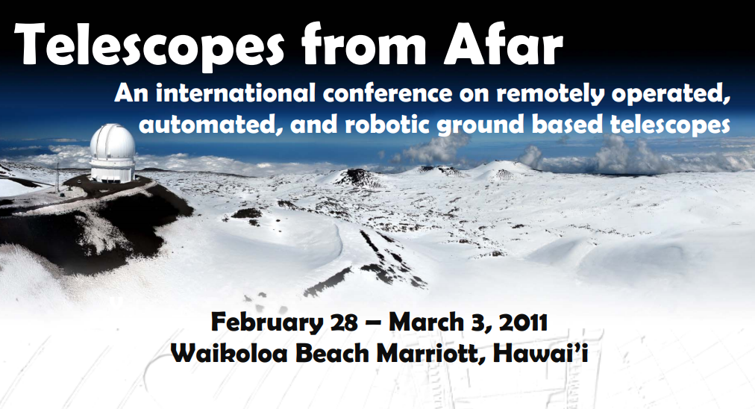
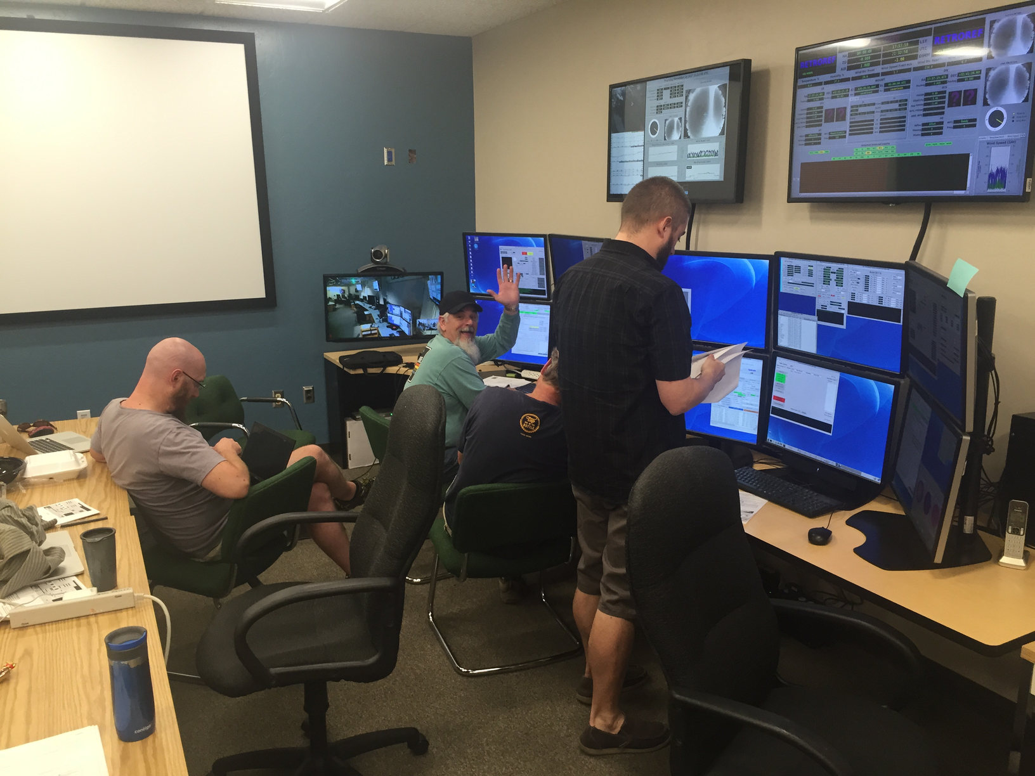

CFHT first fully remotely operated telescope on Maunakea
Remote observing at LBTO (N507)

Slide 3
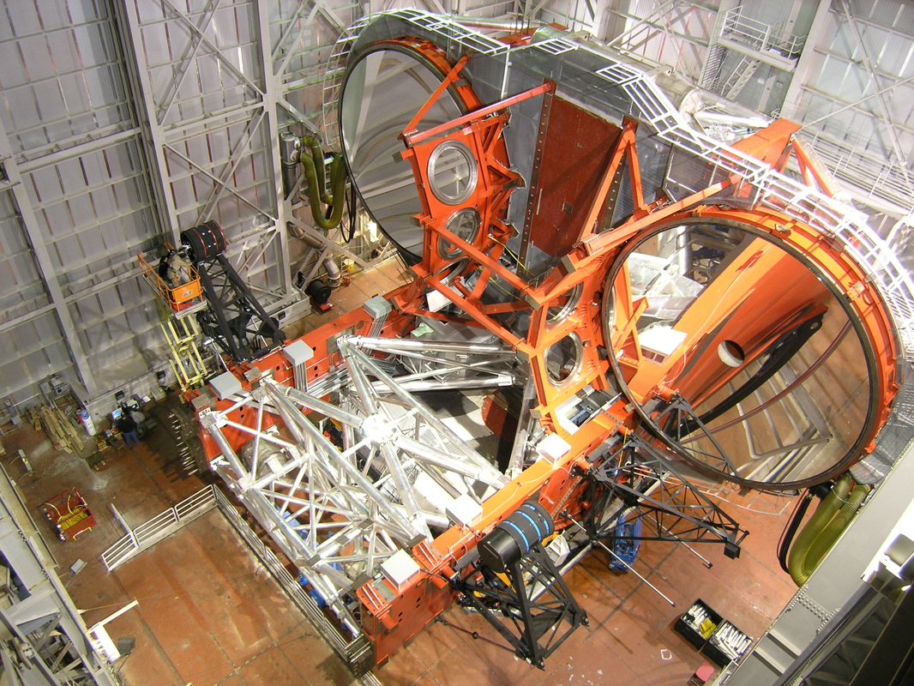
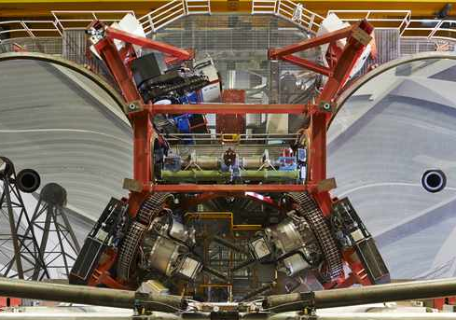
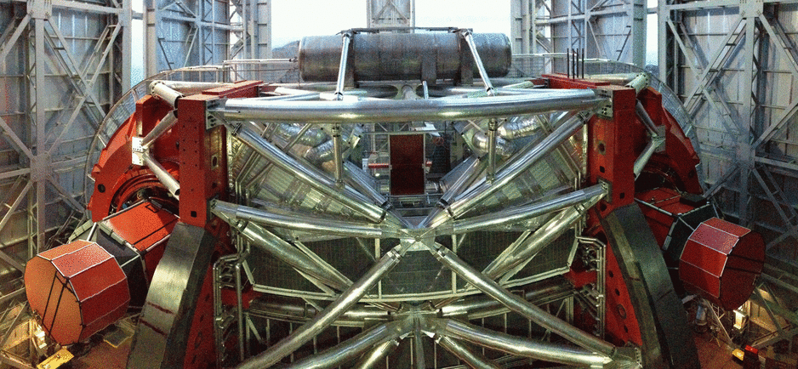
Two 8.4m main mirrors on the same mount
Three pairs of “facility instruments”
LBCs (wide-field CCD mosaic 23’x26’ - 0.226”/pix)
MODS (R∼500 to 2000 spectroscopy over 0.32-1.05 μm - 6' x 6' FOV - long slit and MOS)
LUCI (imaging & spectroscopy - 0.89 μm to 2.4 μm - 4’x4’ FOV - 500 < R < 12,000 - long slit and MOS)
LUCI AO (30”x30” FOV and up to R≈30,000)
PEPSI
(spectrograph
383 to 907nm
R up to 270,000)
Imaging in L-M (LMIRcam) and 10 μm (NOMIC)

Slide 4
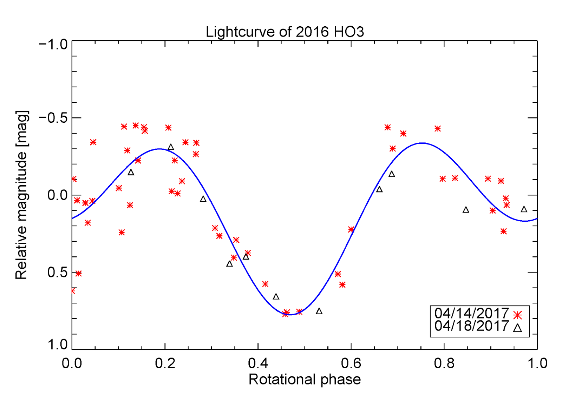
2016 HO3
OSIRIS-REx
LBC
2015 BZ509

Slide 5
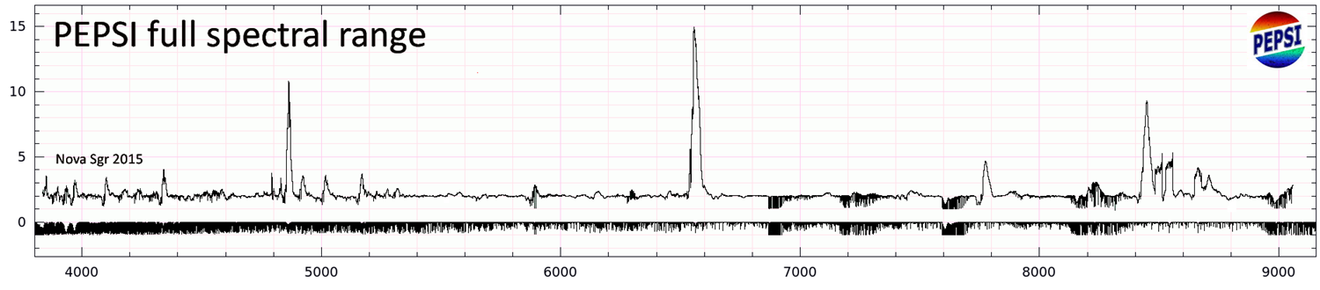
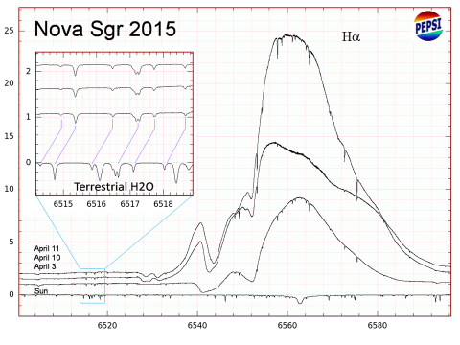
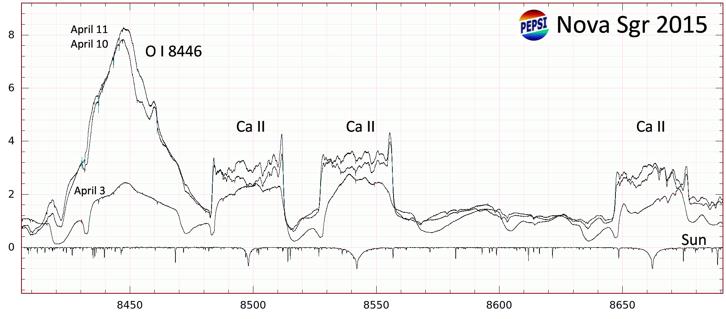

Slide 6
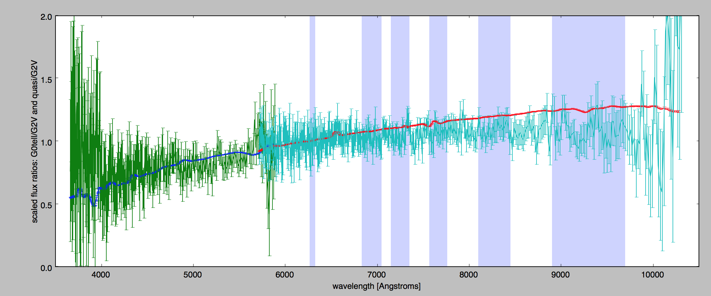
MODS spectra
The visible wavelength spectrum shows a sharp rise in reflectance between 0.4-0.65 microns with a broad plateau beyond.
The scatter 0.8 microns makes it challenging to confirm the presence of a silicate absorption band at ~1 micron, although a weak feature cannot be ruled out.
If real, the silicate could be pyroxene (??)

Slide 7
Why to use LBTO?
When a large telescope is needed (binocular use ~ 11.9m telescope).
When a unique capability is needed (i.e. PEPSI, L-band imaging, 2-color simultaneous photometry, …)
…
Note:
LBTO is not scheduled in queue-mode yet.
The change from one instrument to another is possible but takes time (10 to 30mn).
There is no event alert watchdog and automated telescope response yet.

Slide 8
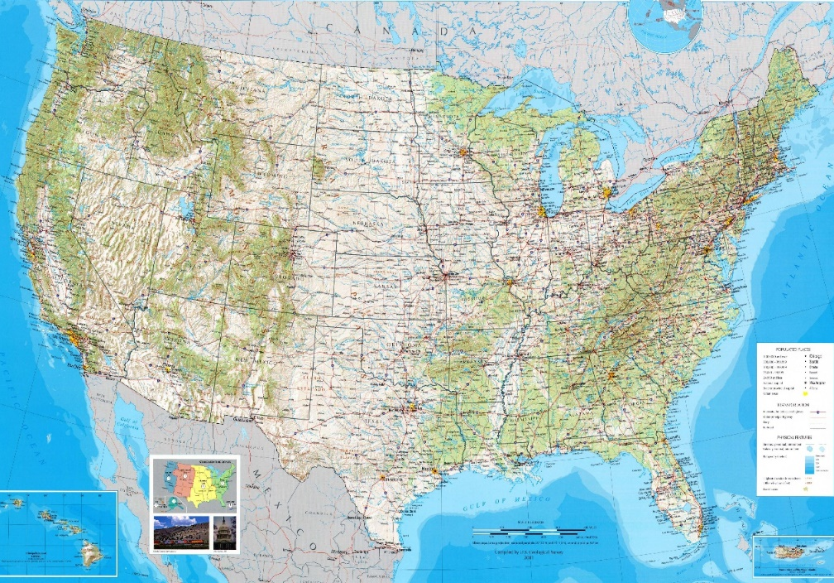
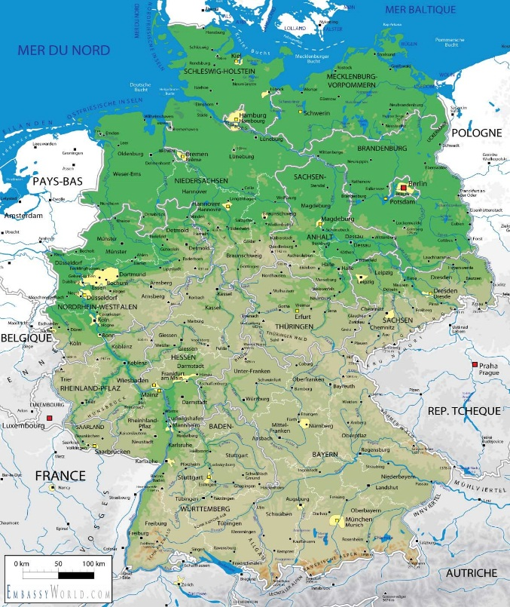
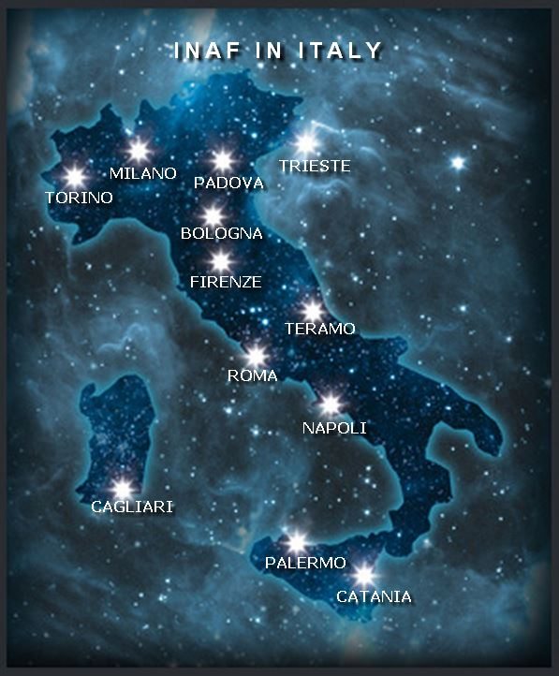
How to use LBTO?
UM
OSU
A pre-allocated TOO program through TAC (UA has a 25% share of LBT).
A request for Director’s Discretionary Time.
A collaboration with LBTO science staff and using D-time.
A collaboration with colleagues from other LBTO partners.
UND
UV
UA System
AIP Potsdam
MPFR Bonn
MPIA Heidelberg
MPE Garching

